Slide 1

Covid Data Analysis
By: Landon Wilson and Christopher Bodea
Notes:
Chris

Slide 2

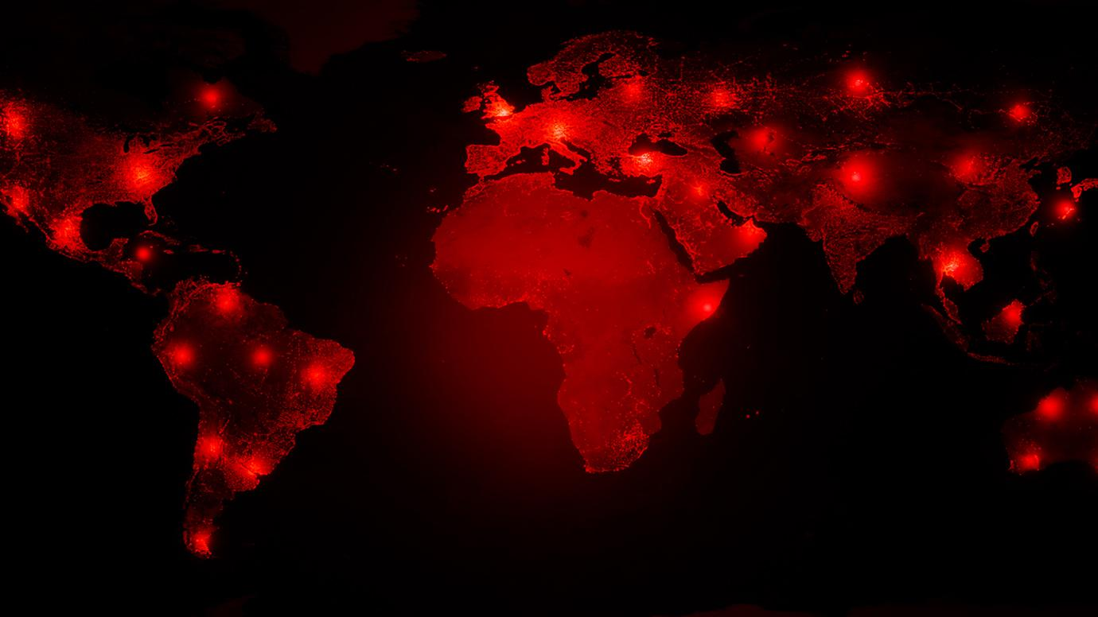
Points of Interest and Purpose
COVID subject of most conversations in the US since March of 2020
There is a TON of data available
truly is a “once is a lifetime experience”
COVID changed the way we live our lives
Questions we wanted answers to:
How big of an impact do the different mask policies make?
Does it matter when states mandated masks?
What kind of trends do the various states follow?
Are there particular regions that were hit harder than others?
Did the gov of the state have an impact?
...and more
Notes:
Chris

Slide 3

Data Collection/How you found you data/Cleaning
Notes:
Landon

Slide 4


Data Collection
Our three sources were as follows:
CSV with covid tracking data that contains the state, the number of deaths, hospitalizations, number of positive and negative tests and more.
API contained similar data to our CSV however it was broken down data by date which allowed us to get cumulative data and track the deaths and more over a longer period of time
Web Scrape a table that contained the state, state mask policy, and when the state put into place the policy
Notes:
Landon

Slide 5


How We Found Our Data
Finding uncleaned, useful data was surprisingly difficult
Best datasets we found were too small, so we got approval on a slightly smaller set of files
Sought for data that spanned a significant period of time
Searched on reliable websites like the CDC official site and other .gov websites
data.gov
healthdata.gov
cdc.gov
Notes:
Landon

Slide 6
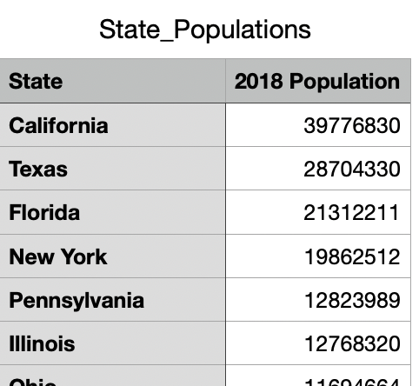
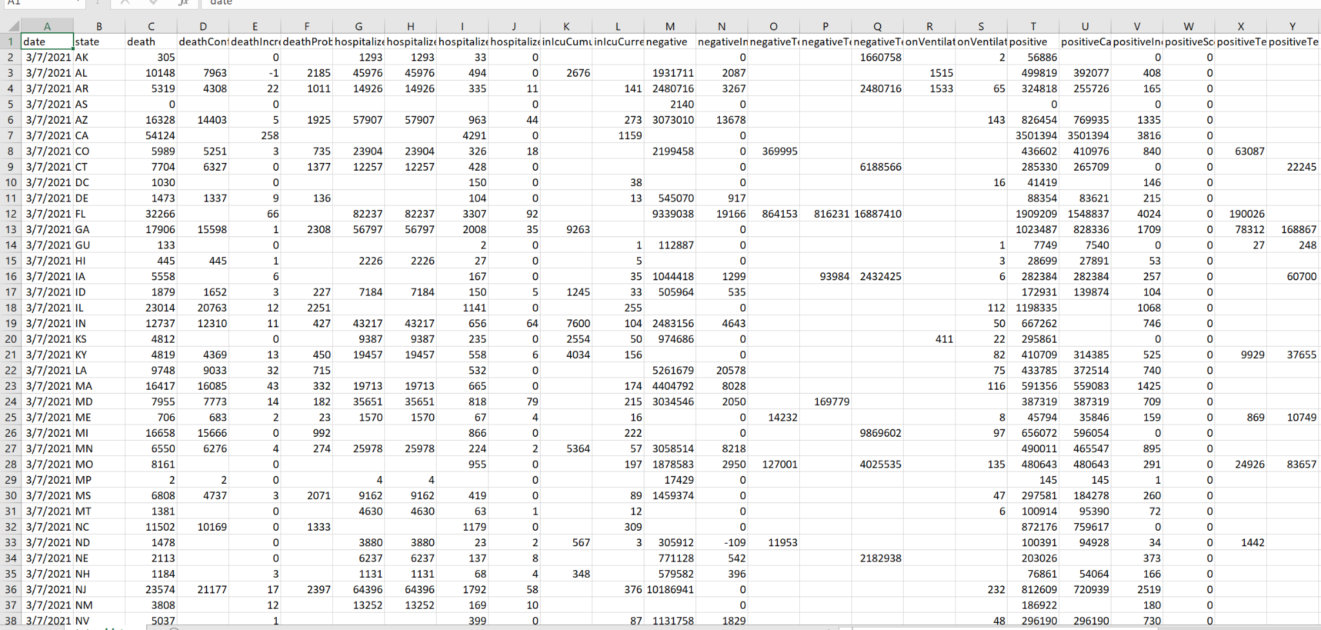
Cleaning the Data
Our data had a lot of inconsistency:
In CSV file, we faced a large amount of blank cells "no data"
In web scrape and state population file, state names were not abbreviated "Georgia" go "GA"
In CSV file we had to change the data type strings to numbers
In all of our datasets we decided to alphabetize the information by state
In json file, changed date to proper date format: day ,month, year(all as one eight digit number) month-day-year
Notes:
Chris

Slide 7
Analysis, Insights, and Visuals
Notes:
Chris

Slide 8
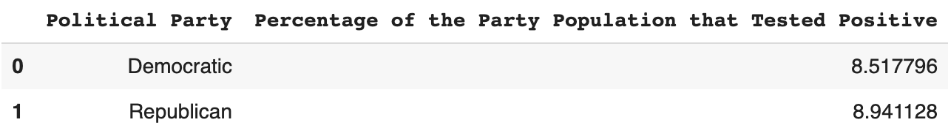
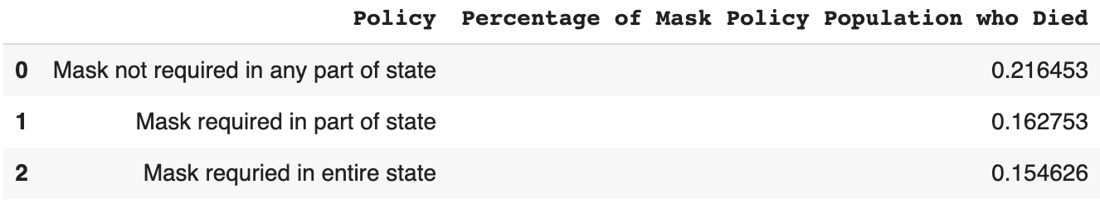
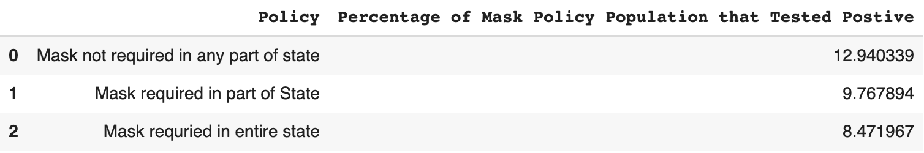
5 Insights
The dominant political affiliation of each state does not seem to have a significant impact on COVID-19 positive case counts, although the Democrats have slightly lower numbers.
States that require masks in the “Entire State” had a lower percentage of deaths related to the population than states that mask requires for “Part of State” or “Not Require” a mask.
States that require masks in the “Entire State” had a lower percentage of the population test positive than states that mask requires for “Part of State” or “Not Require” a mask.
Notes:
Chris

Slide 9
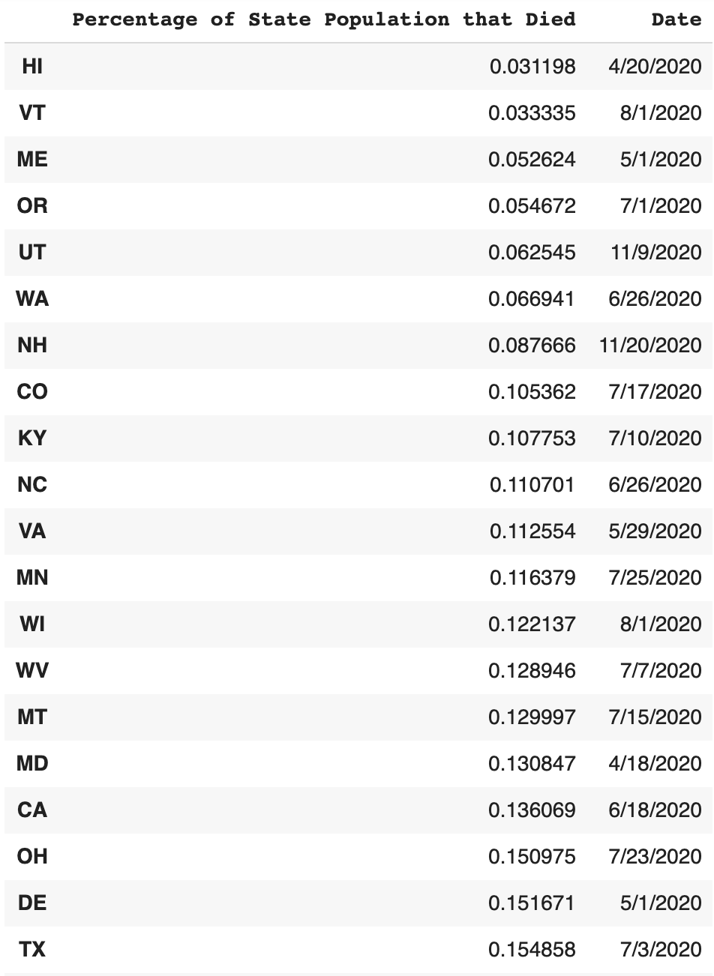
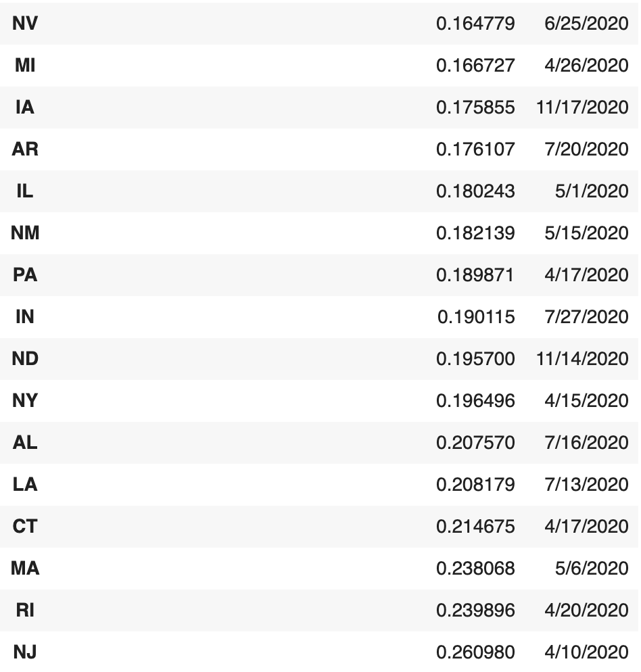
5 Insight Cont.
4. The time at which states implemented “Entire State” mask mandates did not have a effect on the percentage of deaths in each state.
Notes:
Chris

Slide 10
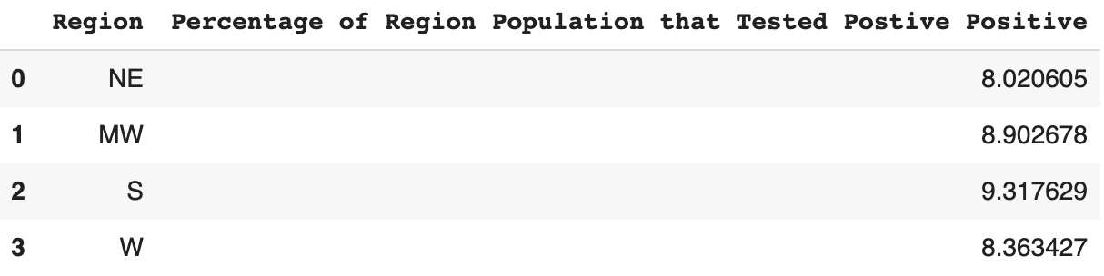
5 Insights Cont.
5. Most regions of the United States have states with very high counts and very low positive case counts, showing that detected COVID-19 infections are more impacted by each state, rather than by each region.
Notes:
Landon

Slide 11
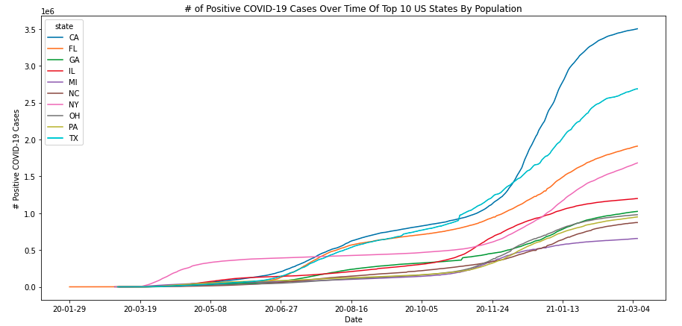
Visual 1
Notes:
Landon

Slide 12
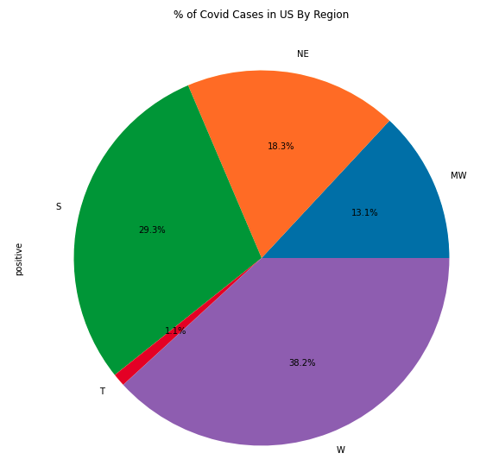
Visual 2
Notes:
Landon

Slide 13
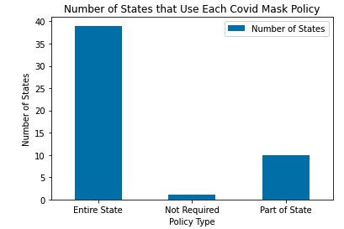
Visual 3
Notes:
Landon

Slide 14
Overall Results and Conclusion
Notes:
Chris

Slide 15


Findings
Mask mandates have a significant impact on the spread of the COVID-19 virus
States with mask mandates had less detected cases than states that did not enforce masks across the state
States with mask mandates had lower death rates than states without mask policies
Most states enforced a full-state mask mandate at some point
The time in which mask mandates were legally enforced did not have a significant impact on the spread of the virus
No correlation between region of US and COVID-19 case count
Most states follow a similar trend in detected case rate over time
No correlation between party affiliation and COVID-19 case count
Notes:
Chris

Slide 16
Thank you!

